Slide 1
QAD Supplier Portal: Alerts

Slide 2
Course Overview
Supplier Portal — Alerts
Introduces alerts in the Supplier Portal Web UI
Describes features for users and administrators

Slide 3
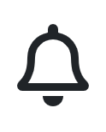
Alerts in Supplier Portal Web UI
Supplier Portal — Alerts
Alerts provide users with notifications of changes to field values when conditions are met
Users can define alerts for enabled Supplier Portal views
Many options for conditions and notification delivery
Users can configure how they receive alerts:
Inbox
Email
Administrators can define alerts for users
Notes:
Alerts provide the capability to notify users when certain conditions are met.
For example, you can create an alert so that if a purchase order’s revision number changes, a notification is automatically sent to a user's Inbox or email address.
Alerts can be created by users and by administrators, who can define alerts for users.
NOTE: In this release (as of April 2019), alerts are available only for purchase orders headers and purchase orders lines.

Slide 4
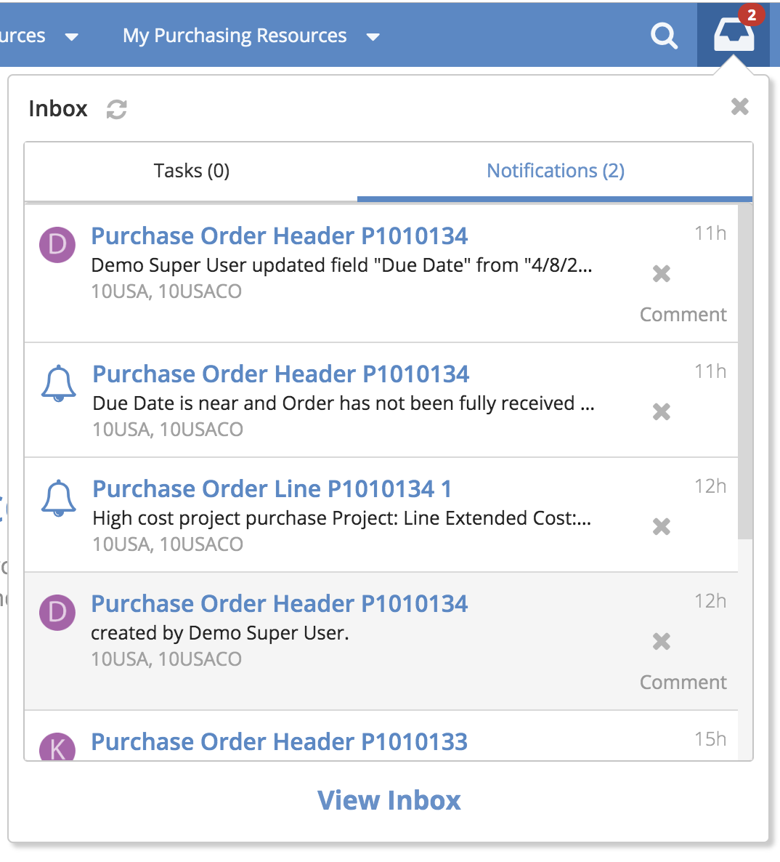
Alert Notification Delivery
Supplier Portal — Alerts
Alert notifications sent to user’s Inbox and/or email
Notes:
Users will typically get alerts while using SP by checking their Inbox. A red indicator lets users know that they have unread notifications in their Inbox. Users can click on the notifications and then go directly to the function of interest. Users can also have email messages sent to them. Note that these emails are from the system, and, as such, a user can’t reply to them, but they provide a helpful notification in case the user is not in the SP Web UI at the time.

Slide 5
Alerts Defined by Users
Supplier Portal — Alerts
Bell icon displayed on views enabled for alerts
Example: Purchase Orders
Click the bell icon to open the pop-up window for setting alerts
Notes:
The bell icon is displayed on the upper right corner of the form for views that are enabled to have alerts.
Only views where alerts are possible display the bell icon. If you don’t see the bell icon, then alerts are not enabled for that view. The administration info later in this training provides more information about enabling alerting for specific views.
Note that a “view” is a generic term for any user interface screen in the Supplier Portal Web UI. Views can consist of a browse, a form, a hybrid browse + form, and so on.

Slide 6
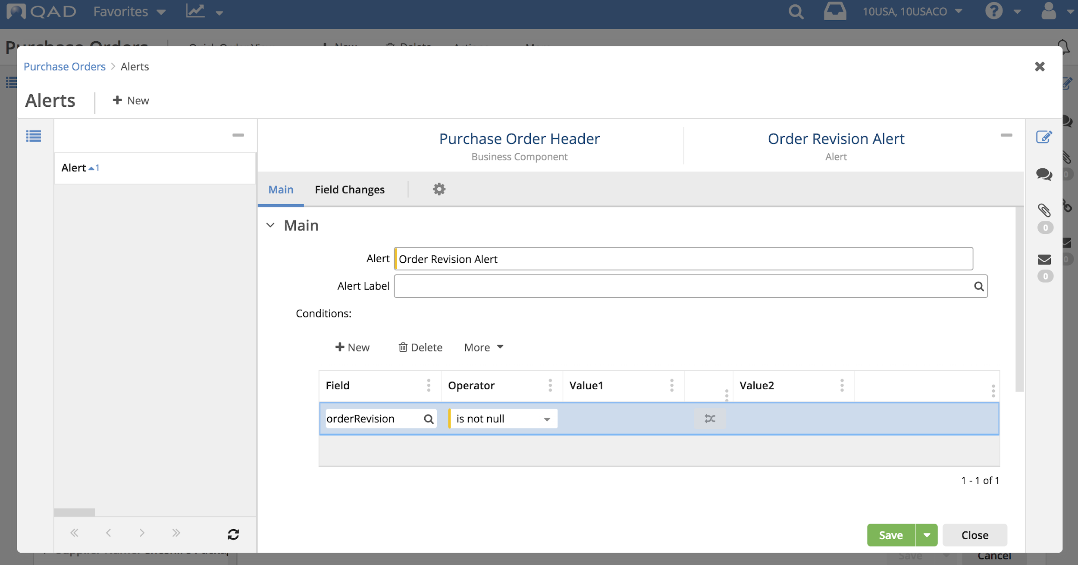
Configure Alerts — Alert Name and Conditions
Supplier Portal — Alerts
Enter a name for the alert
Configure conditions for the alert
Notes:
Alert: Enter a name for the alert.
Alert Label: (Reserved for future use.) Select a label for the alert name.
Conditions: You can have alerts about changes to fields when specific conditions are met. In the Conditions panel, define the conditions to use for getting alerts when conditions are met.
Click New to define a condition.
Field: Select a field from the business component.
Operator: Select from the following: equals, does not equal, contains, not contains, range, greater than, greater or equal to, less than, less or equal to, in list, not in list, starts with, ends with, is null, is not null. For operator that require one value, use the Value1 field. For operators that require two values, use the Value1 and Value2 fields.
Value1: Select from available values or click the toggle icon to select available fields.
Value2: For operators that require two values, select from available values or click the toggle icon to select available fields.

Slide 7
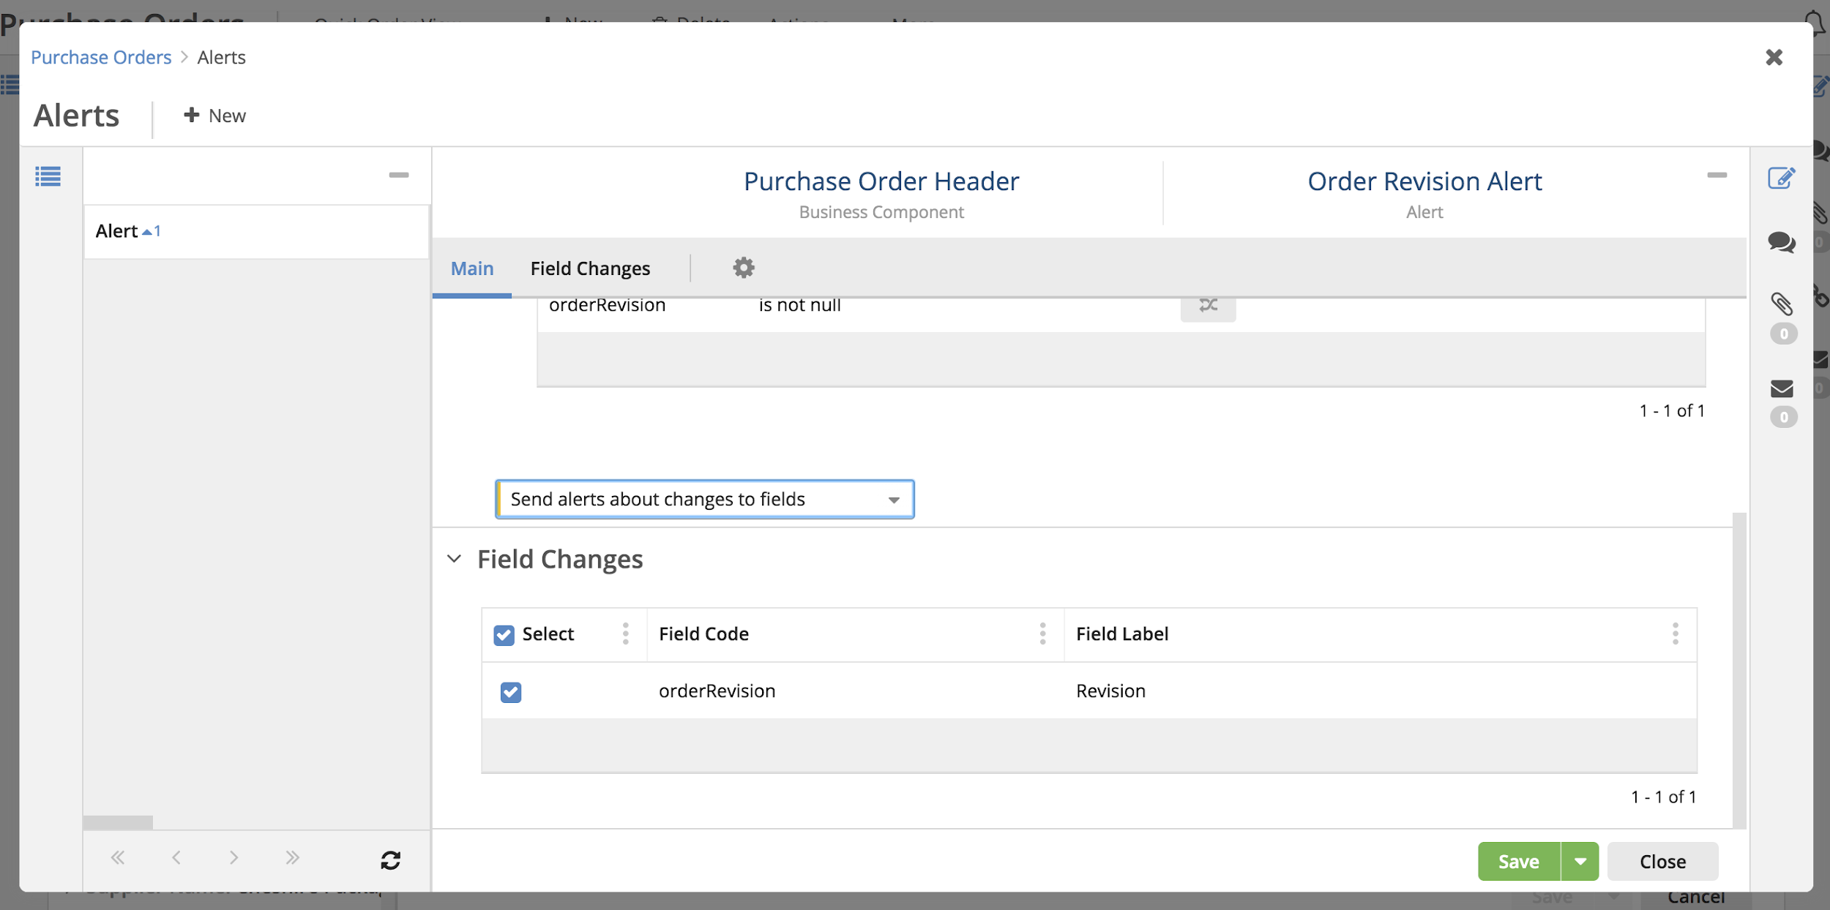
Configure Alerts — Send Alerts About Changes to Fields
Supplier Portal — Alerts
Select to get notifications about any changes to field values.
Select fields for which you want to get notifications.
Notes:
From the drop-down, select Send alerts about changes to fields to get notifications about any changes to field values. In the Field Changes panel, select the fields for which you want notifications.

Slide 8
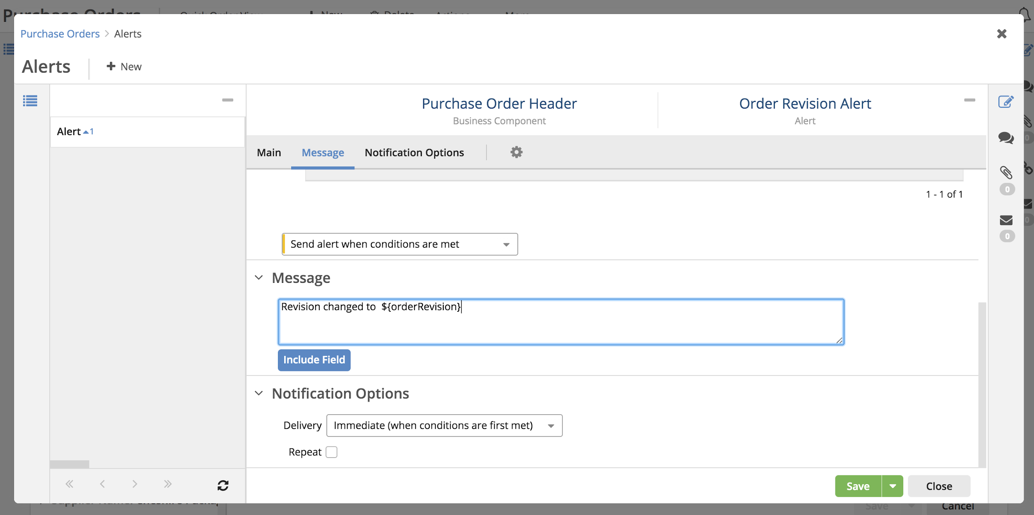
Configure Alerts — Send Alerts When Conditions Are Met
Supplier Portal — Alerts
Select to define message and notification delivery options when conditions are met
Notes:
From the drop-down, select Send alert when conditions are met to define a message and notification delivery options for when the specified conditions are met. In the Message and Notification Options panels, define the message content and delivery options.

Slide 9
Configure Alerts — Immediate Notification
Supplier Portal — Alerts
Select for Immediate Notification
Notes:
Select Immediate (when conditions are first met) to have the notification sent, as soon as conditions are met. Select Repeat to repeat sending the notification while the conditions are met for the specified days, hours, and minutes.

Slide 10
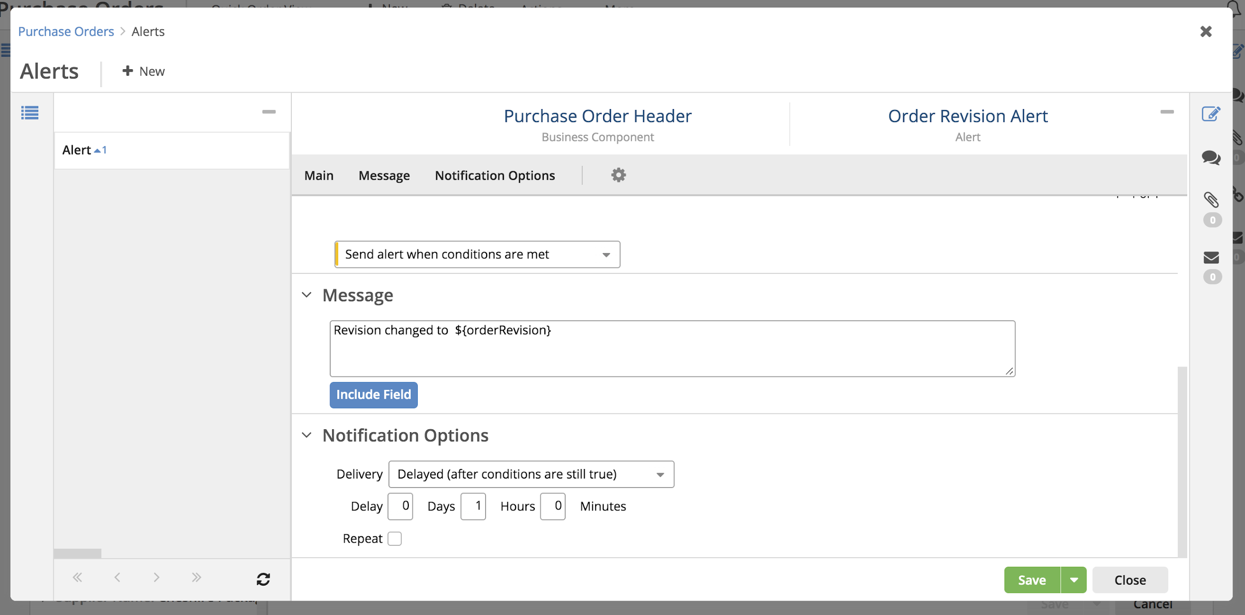
Configure Alerts — Delayed Notification
Supplier Portal — Alerts
Select for Delayed Notification
Notes:
Select Delayed (after conditions are still true) to have the message sent after a time delay (in days, hours, and minutes). Select Repeat to repeat sending the notification while the conditions are still true for the specified days, hours, and minutes.

Slide 11
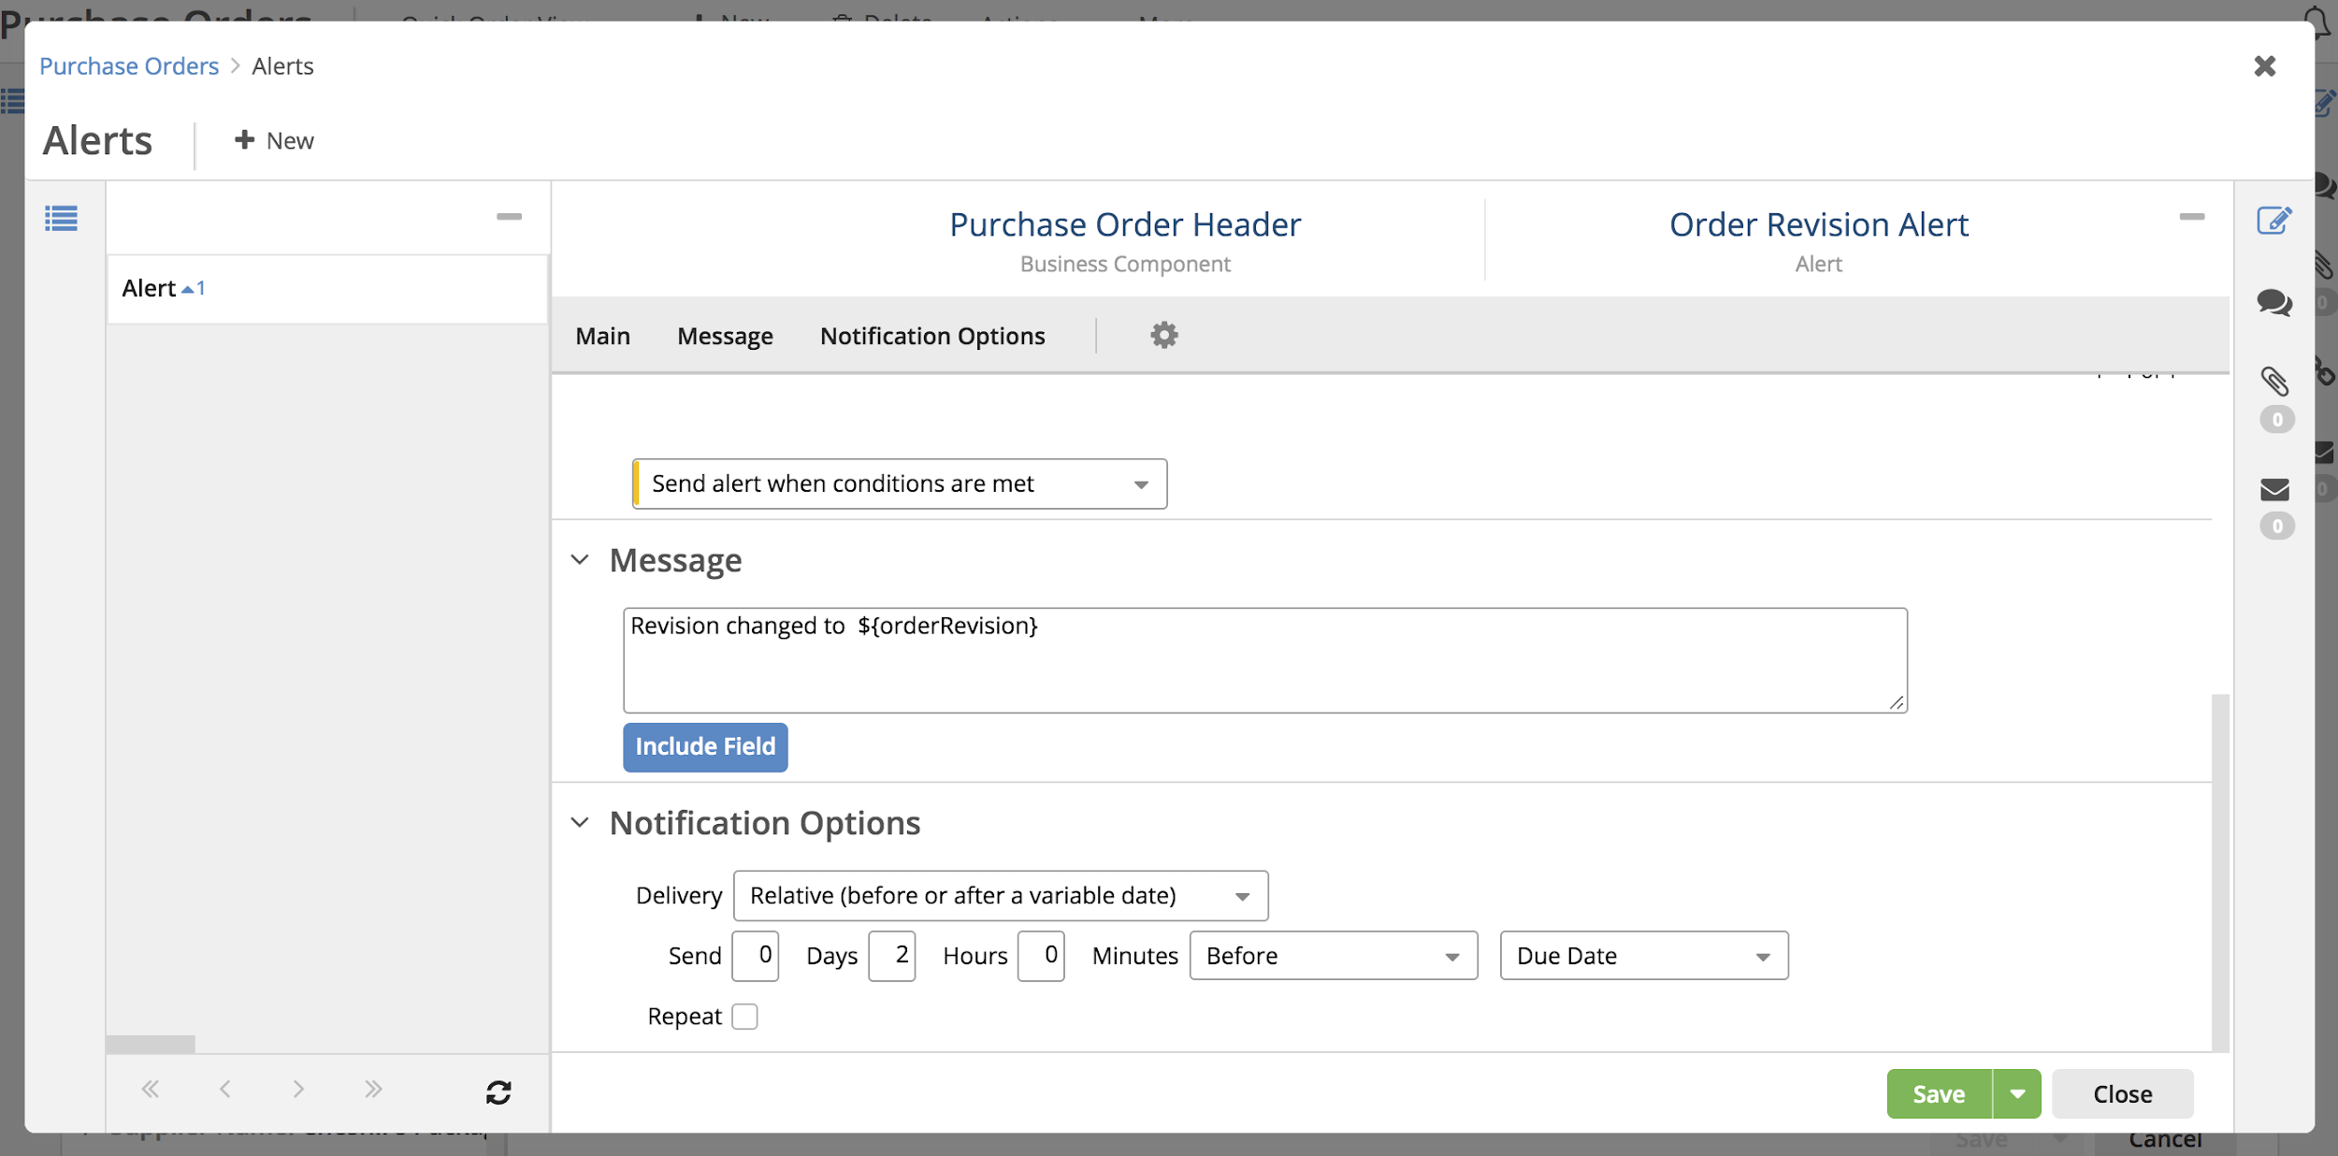
Configure Alerts — Relative Notification
Supplier Portal — Alerts
Select for Relative Notification
Notes:
Select Relative (before or after a variable date) to have the notification sent within a specified time (in days, hours, and minutes) before or after a date provided by selected date field. Select Repeat to repeat sending the notification for the specified days, hours, and minutes.

Slide 12
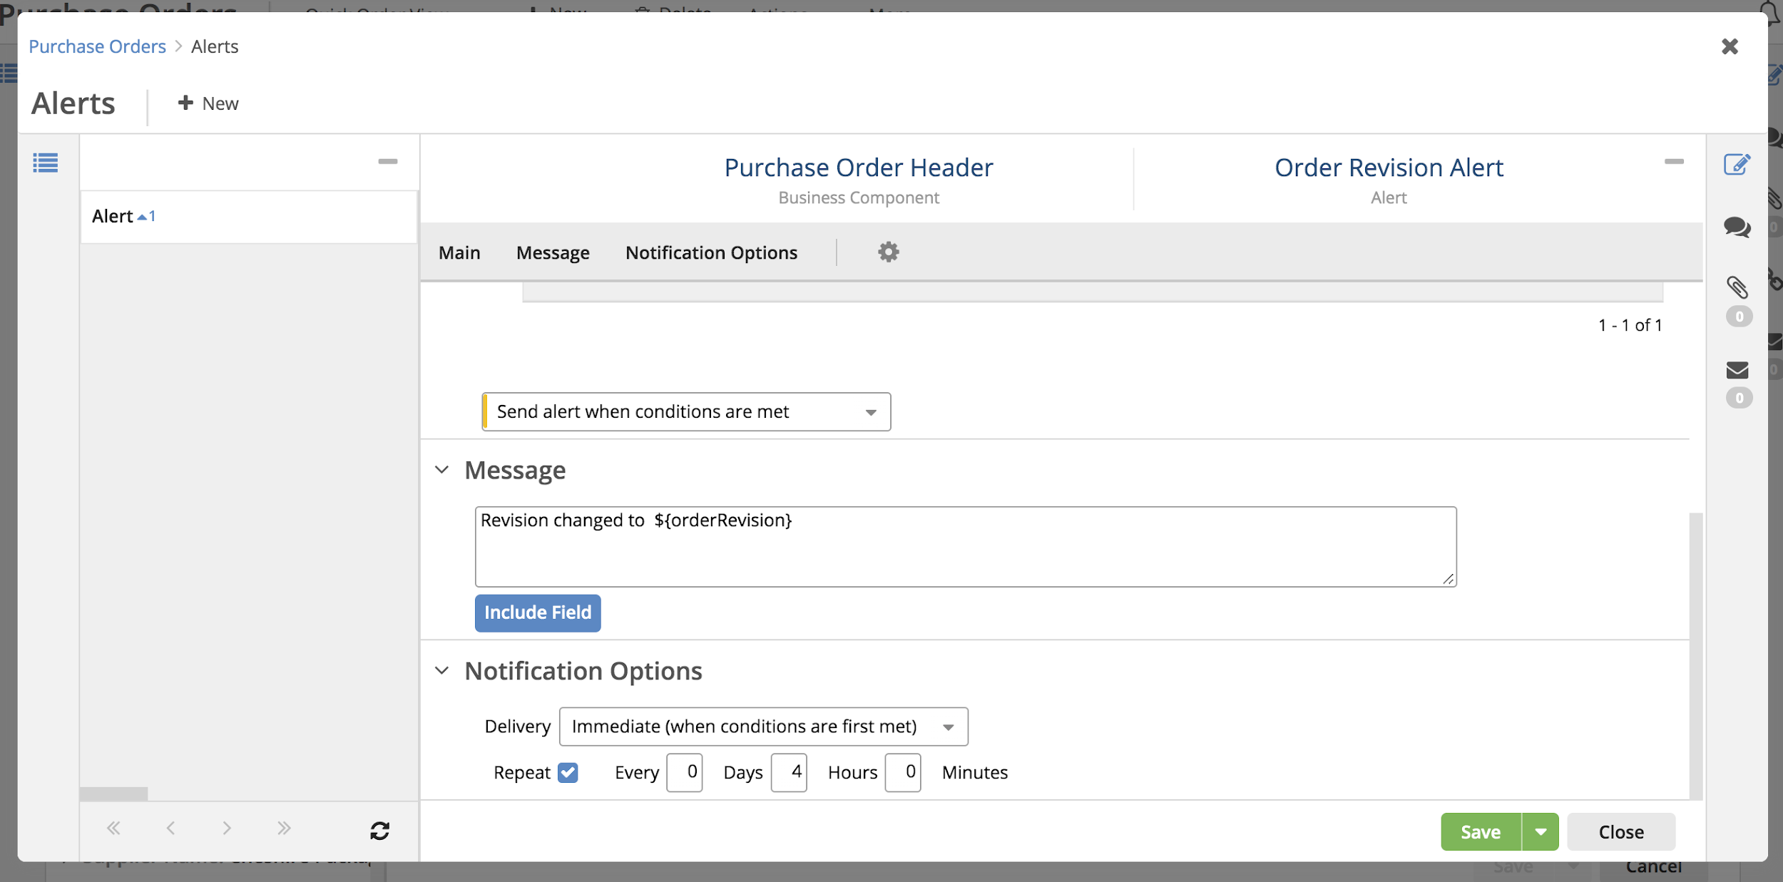
Configure Alerts — Repeat Notifications
Supplier Portal — Alerts
Notes:
Depending on the Delivery option selected, specify how often to repeat the notification in days, hours, and minutes.

Slide 13
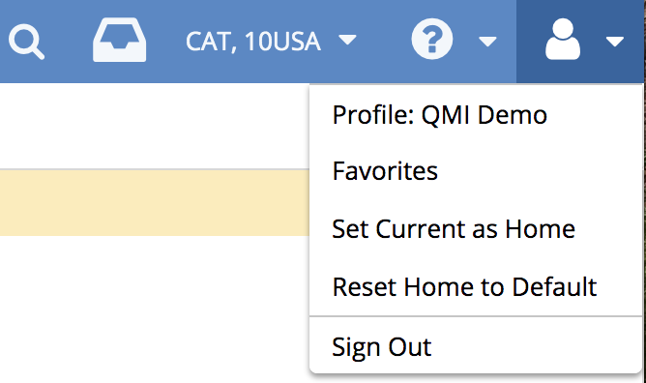
User Notification Preferences
Supplier Portal — Alerts
Profile settings include options for alert notification preferences

Slide 14
User Notification Preferences — Category Settings
Supplier Portal — Alerts
User selects whether to receive alert notifications
Select for alert delivery to Inbox and/or Email
Notes:
Receive Notifications: Select whether the user will receive notifications.
Category Settings: Category settings indicate whether notifications for each notification category (Activity, Alerts, and Reports) will be sent to the user's QAD Web UI Inbox and/or email address. In this case, the user wants to have alerts sent to their QAD Web UI Inbox.

Slide 15
User Notification Preferences — Event Settings
Supplier Portal — Alerts
Select for delivery to Inbox and/or email
Notes:
Event Settings: A notification category can include various types of events for a category. Event settings indicate whether notifications for each category event will be sent to the user's QAD Inbox or email address. The user can choose either All (send all notifications for ) or None.
For the Alerts category, we have two types of events: Alert Message and Field Tracking.
An Alert Message event is when a message notification is generated based on the conditions and message specified for an alert defined with the Send alert when conditions are met option specified.
A Field Tracking event is when a system notification is sent because of a field change, as specified for an alert defined with the Send alerts about changes to fields option specified.
Typically, for alerts, a user would want to receive notifications for both of these event types, but managing the event settings can help to reduce Inbox clutter.
For example, if a particular user is getting many alert notifications about ongoing changes to fields (Field Tracking) that are in general not of interest to the user, but still wants to get the messages for when specific conditions are met (alert message), they can control that here, reducing the number of alert notifications in their Inbox.

Slide 16
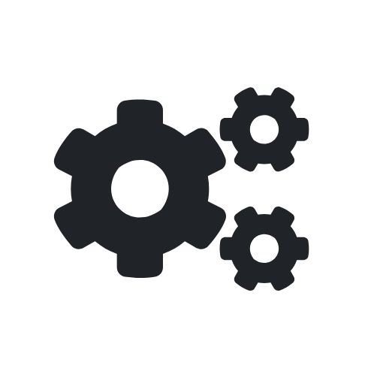
Alert Administration
Supplier Portal — Alerts

Slide 17
Alert Administration — Key Concepts
Supplier Portal — Alerts
Views — a view is a generic term for any user interface screen /page in the Supplier Portal Web UI. Views can consist of a browse, a form, a hybrid browse + form, and so on.
Business Components — a business component provides the underlying data and logic for a well-defined business activity in the system such as kanban cards, schedules, or purchase orders.
Notes:
Normally, users do not have to think about business components but administrators should be familiar with this concept because some of the administration tasks can involve selecting and managing the underlying business components.

Slide 18
Alert Administration — Key Concepts
Supplier Portal — Alerts
A view provides the user interface screen for one or more business components, which provide the underlying data and logic.
Example:
The Purchase Order Header and Purchase Order Lines business components provide the data and logic for the Orders view
Notes:
As an administrator, it is important to understand the concept of business components (as opposed to views) because configuration of collaboration activity (including alerts) is set at the level of the underlying business components.

Slide 19
Alert Administration — Key Concepts
Supplier Portal — Alerts
Alerts and Activity Tracking
Views whose business component(s) have one or more fields enabled for activity tracking are then enabled for having alerts, and will, therefore, show the bell icon
Only business component fields that are being tracked can be used for defining alert conditions or for designing the alert notification messages

Slide 20
Alert Administration — Activity Tools
Supplier Portal — Alerts
Activity Tracking view — administrators must configure which business components can be tracked by the system for alerts
Alerts view — administrators use the Alerts view to create and manage alert definitions for users
Notes:
When initially configuring a system, an administrator should first set up Activity Tracking for the business components that they want to track, and then set up alerts as needed. However, once that is set up, administrators would typically go to Alerts to manage the alert definitions.

Slide 21
Alert Administration — Customer Administrator Role
Supplier Portal — Alerts
Customer Administrator role menu Activity drop-down:
Activity Tracking
Alerts
Notes:
When initially configuring a system, an administrator should first set up activity tracking for the business components that they want to track, and then set up alerts as needed.
A customer administrator (a user in the Customer Administrator role) can specify which business components to track (using Activity Tracking) and then create alerts (using Alerts).
Important: For now (May 2019), a customer administrator can only assign alerts to customer users (admin and non-admin). In June 2019, the full functionality will be available: customer administrators will be able to create alerts for any user working in the subscription (admin, non-admin, supplier and customer). The rest of the users (non-admin customers), can create alerts only directly through the bell icon on Orders (for now), and they cannot delete alerts assigned to them by customer administrators (but they can go to their profile options and select to not get the alert notifications in Inbox or email). Alerts will be able to be created for nearly all business components (an exception would be the site business component, for which alerts are not pertinent).
Note that there are two ways to launch menu items (views): from a role-based menu (as shown here), or you can go directly to the menu search and find the menu item of interest. If you are not sure about the exact name of the thing you are looking for, using a role-based menu is a good approach. If you know the name of what you want, using the menu search can be faster: the menu search features a “type ahead” display so you can quickly select what you want.

Slide 22
Alert Administration — Alerts and Activity Tracking
Supplier Portal — Alerts
Open Activity Tracking from the role menu or menu search:
a
Notes:
This shows how you can open Activity Tracking from the menu search (you can also access it from the Customer Administrator role menu’s Activity drop-down (as shown in the previous slide). As part of SP’s collaboration features, Alerts leverages the Activity Tracking functionality, which also supports the Activity panel. As an administrator, to use alerts, you must specify which fields can be tracked using Activity Tracking. From the Activity Tracking view, you can configure what is being tracked by the system, based on business component.

Slide 23
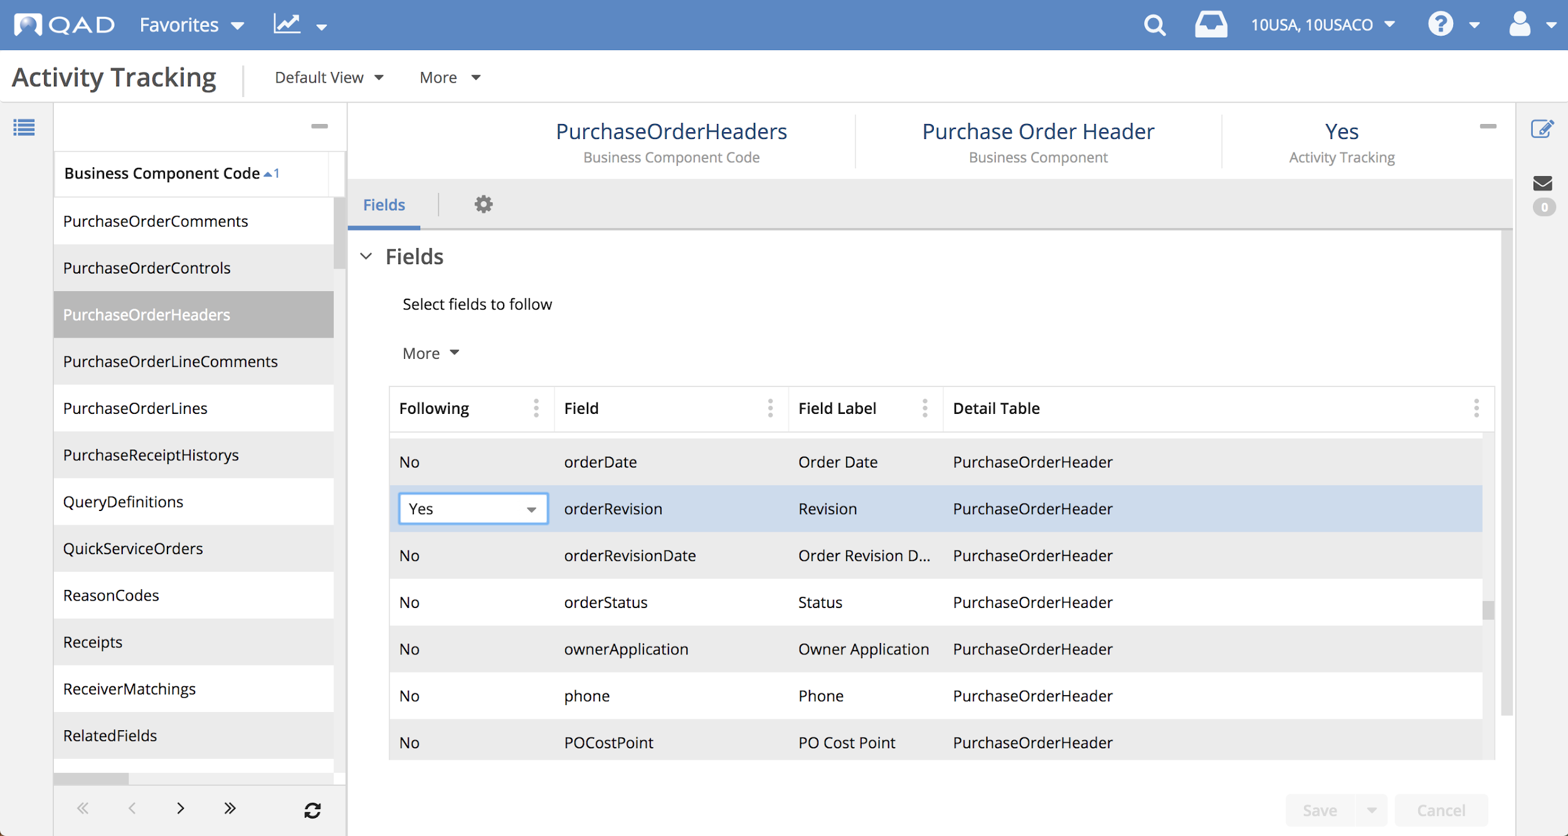
Alert Administration — Alerts and Activity Tracking
Supplier Portal — Alerts
Notes:
Fields that have activity tracking (Following is set to Yes) can also have alerts defined for them. Alerts can be created by users and by administrators. If activity tracking is enabled for a form's business component, the bell icon is displayed on the upper right corner of the form. A user can click on the bell icon to open the Alerts pop-up window for creating alerts. Administrators can access the Alerts view to create, modify, or delete alerts, and to add users for specific alerts.
Note: Business component fields that are not tracked will not be able to be used for conditioning purposes or for designing the message contained in the alerts.

Slide 24
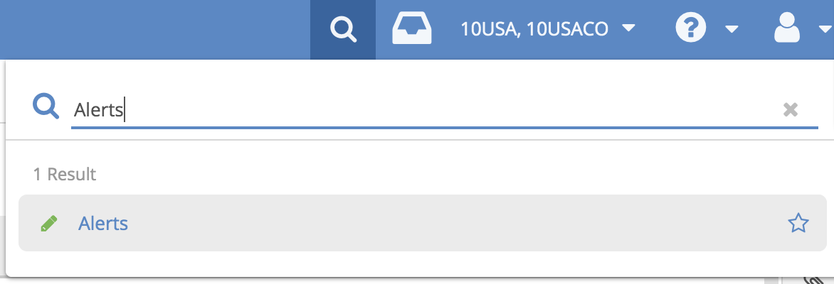
Alert Administration — Alerts View
Supplier Portal — Alerts
Administrators can access the Alerts view to create and manage alerts
Notes:
To manage alerts in the system, administrators can easily access the Alert view from the menu search.

Slide 25
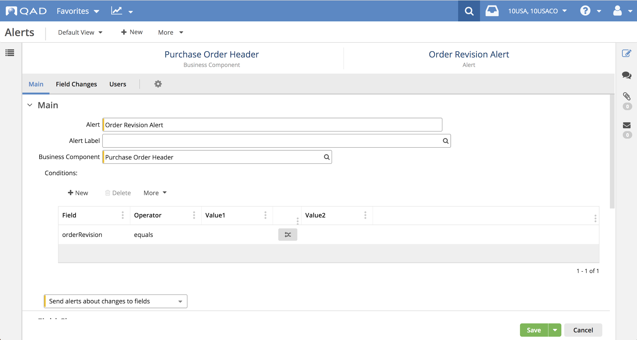
Alert Administration — Alerts View
Supplier Portal — Alerts
Notes:
The Alerts hybrid view is for use by administrators to create and manage alerts. The Alerts view is just like the Alerts pop-up window for regular users, which you have just learned about, except that (1) the Alerts view specifies the business component of interest (a business component provides the underlying data and logic for a given user interface view) and (2) includes a Users panel for assigning users to alerts.

Slide 26
Alert Administration — Assigning Alerts to Users
Supplier Portal — Alerts
Alerts view includes Users panel for assigning users to alerts
Select users who can receive alert notifications
Notes:
Administrators can define alerts and also assign them to specific users. Note that the users cannot modify these alerts; only an administrator can modify the alerts defined by an administrator. Users cannot ‘unsubscribe’ themselves from alerts that they are assigned by an administrator, but they can stop receiving alerts by going to their user profile settings and making notification option changes.

Slide 27
Summary
Supplier Portal — Alerts
Alerts provide notifications of field changes when conditions are met
Users can define alerts for enabled Supplier Portal views
Many options for conditions and notification delivery
Users can configure how they receive alerts:
Inbox
Email
Administrators can define alerts for users

